Slide 1
Figure S1 (a-e). Manhattan and quantile-quantile (Q-Q) plots for plant architectural traits across different environments; (a & b) Manhattan and Q-Q plots for Plant height (2015-2018); (c) Manhattan and Q-Q plots for flag leaf length (2017-2018); (d) Manhattan and Q-Q plots for flag leaf width (2017-2018); (e) Manhattan and Q-Q plots for number of tillers (2017-2018).
Note: Number of detected SNPs by four ML-GWAS methods; For brevity we presented here few Manhattan and Q-Q plots.

Slide 2
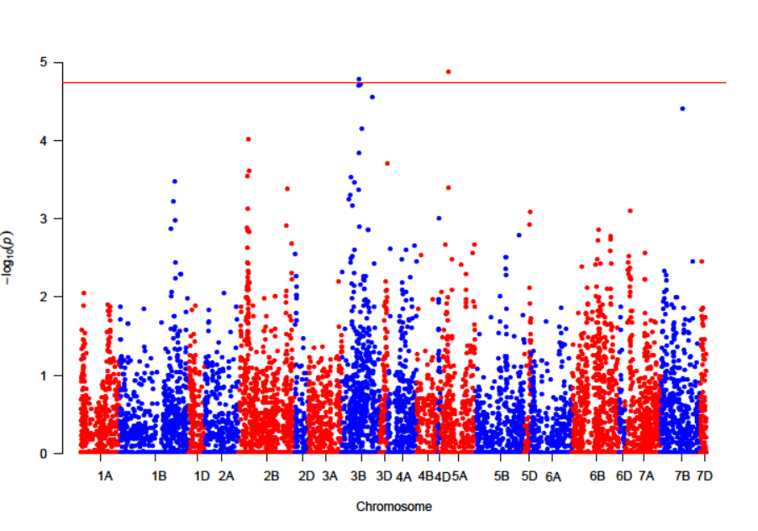
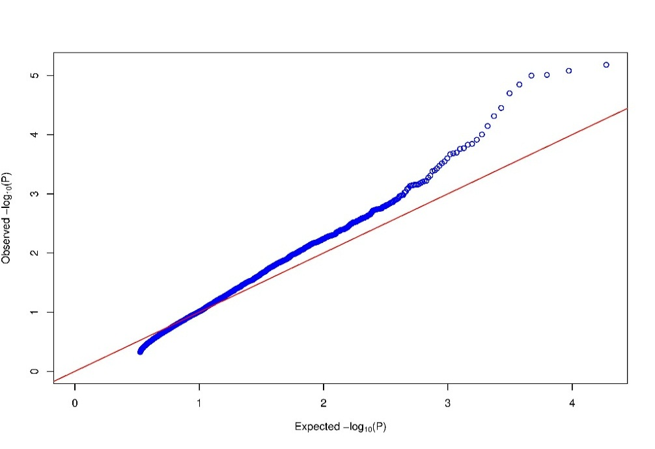
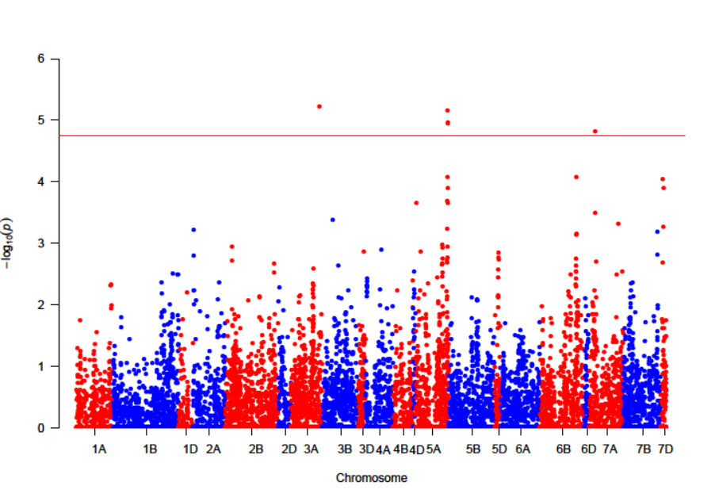
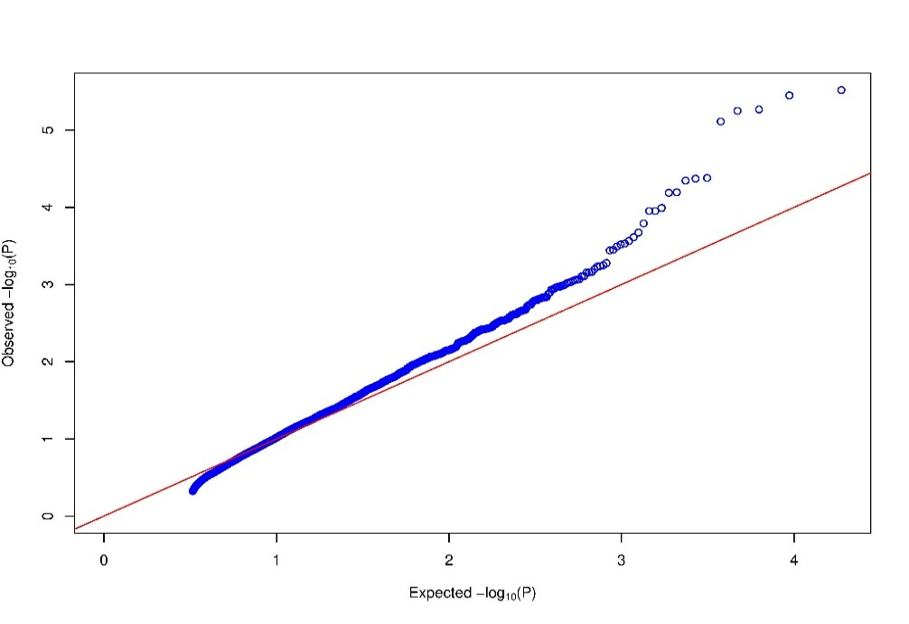
a
PH2015
PH2016

Slide 3
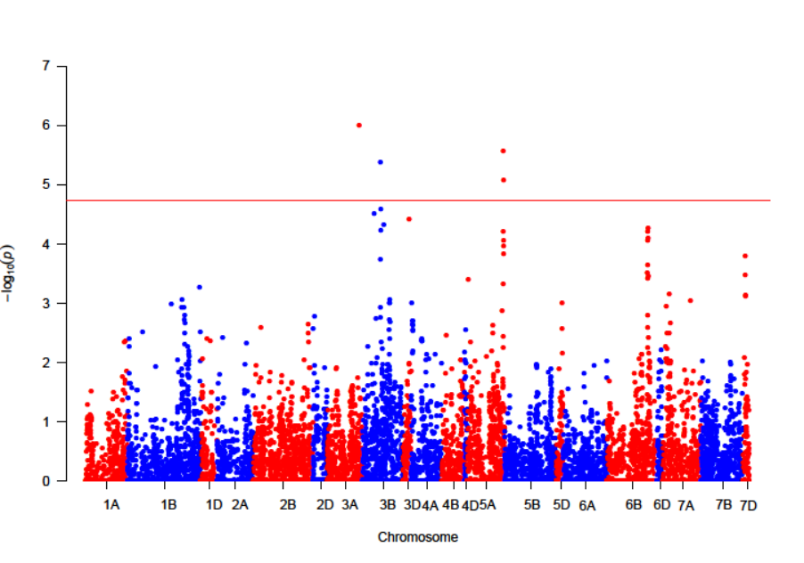
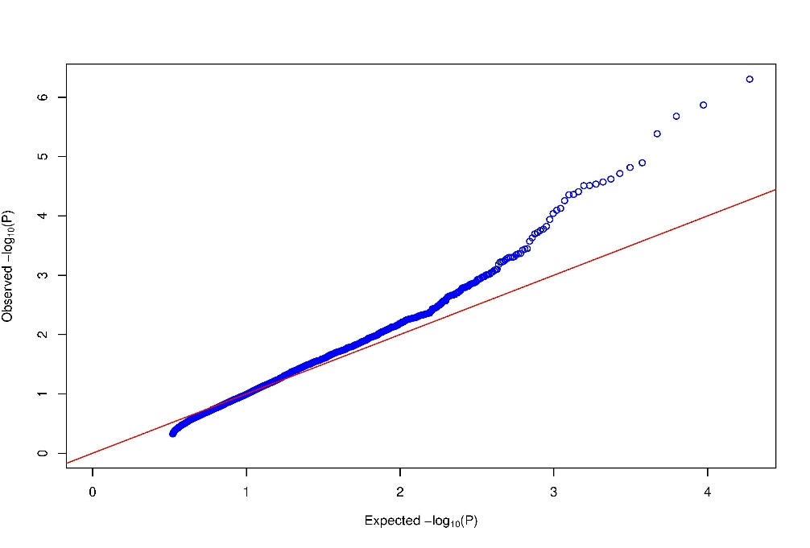
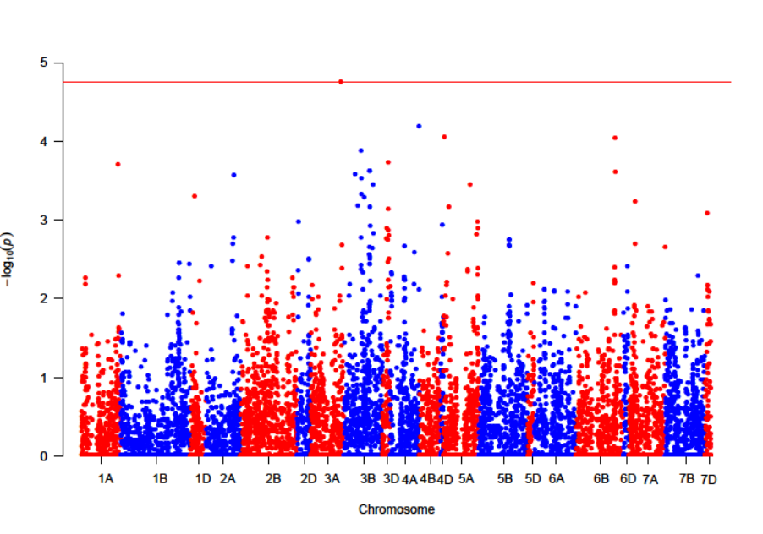
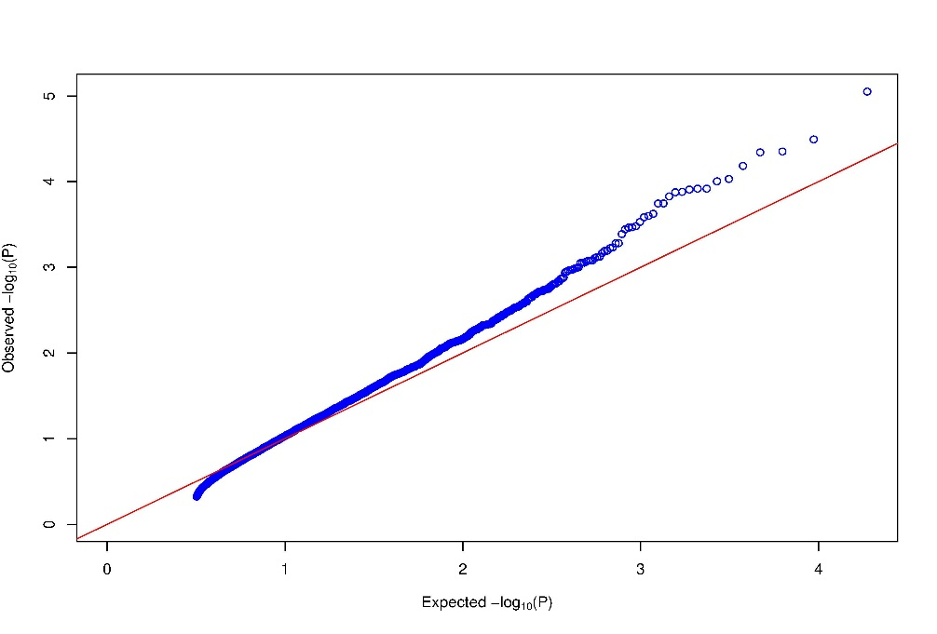
b
PH2017
PH2018

Slide 4
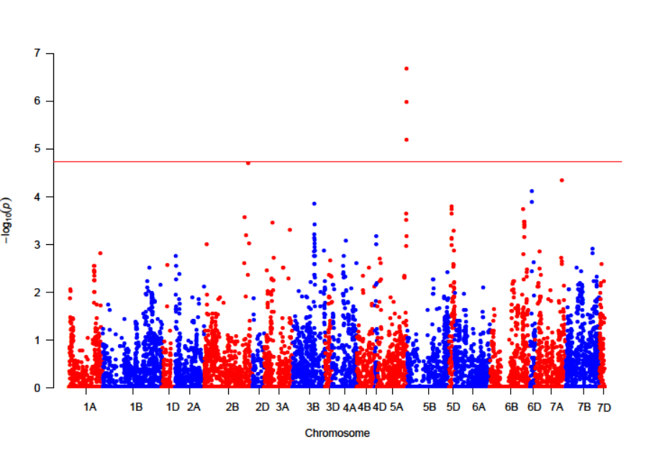
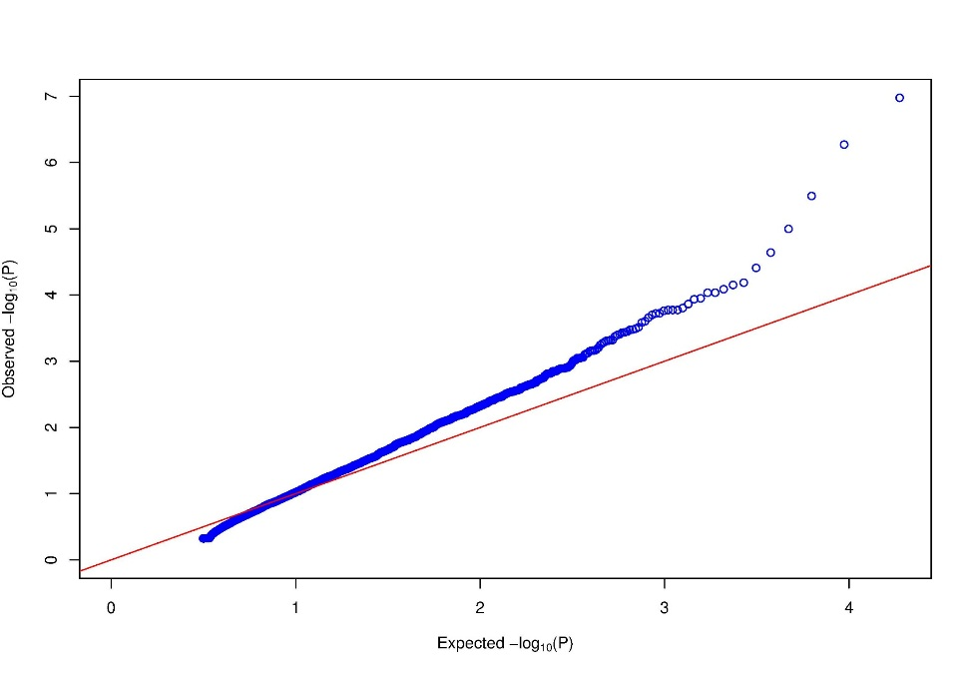
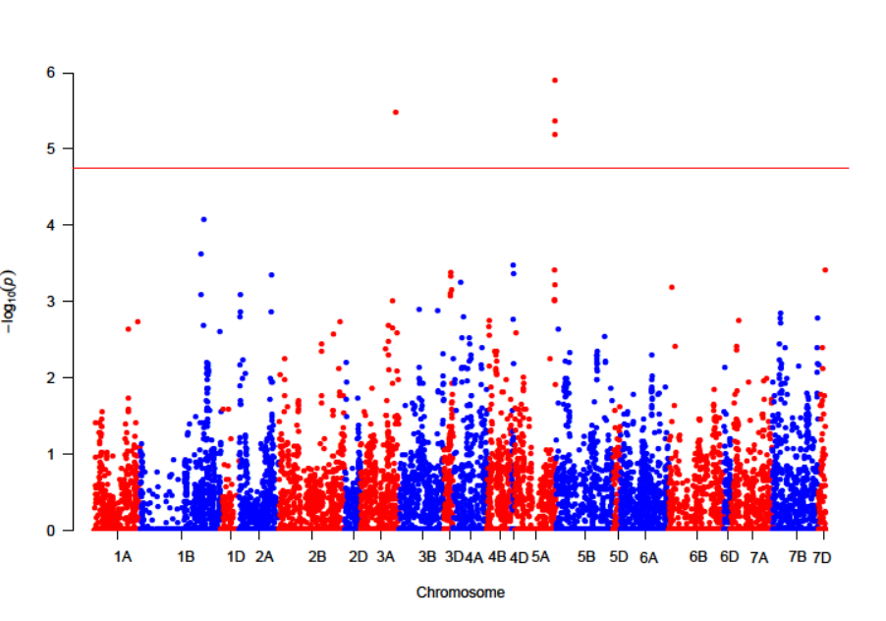
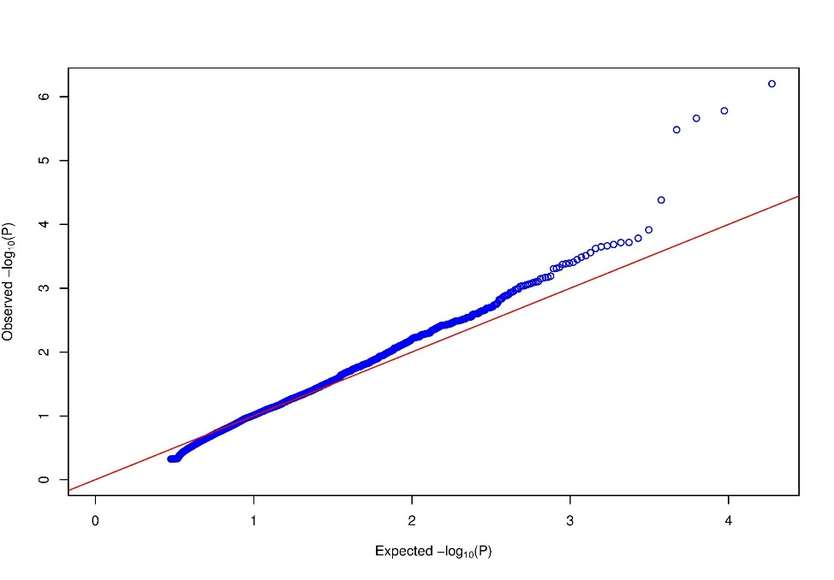
c
FLL2017
FLL2018

Slide 5
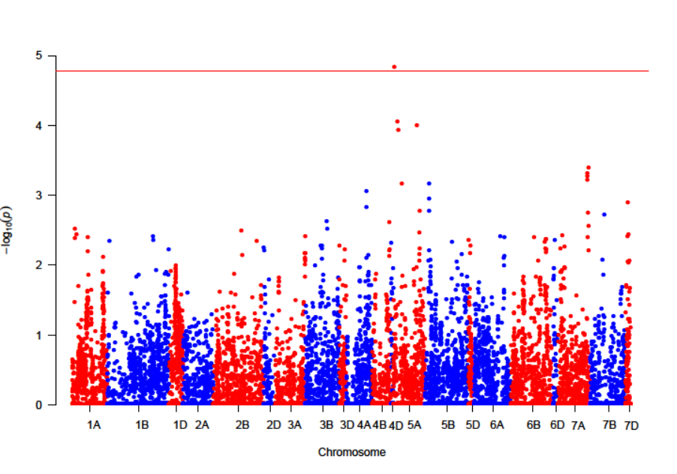
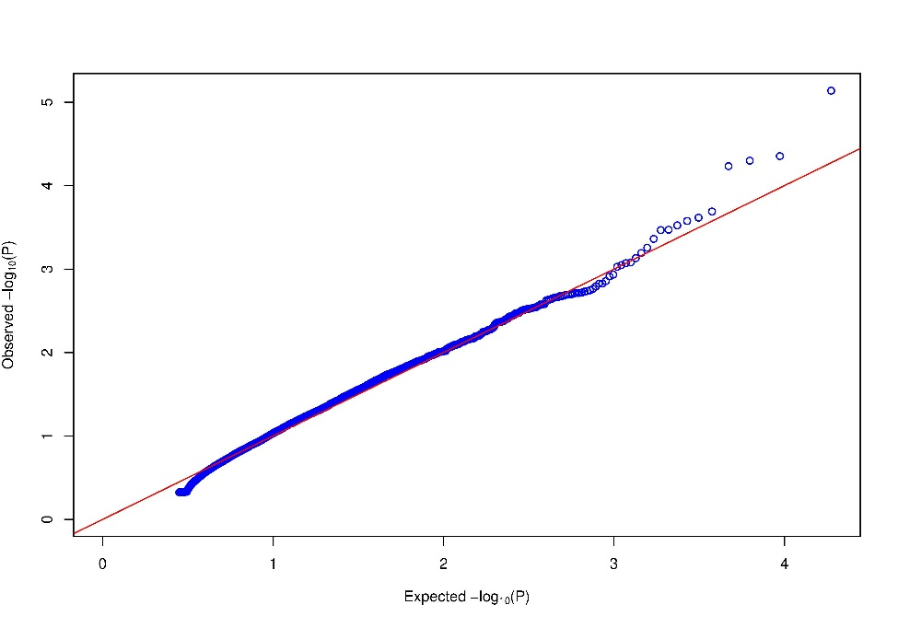
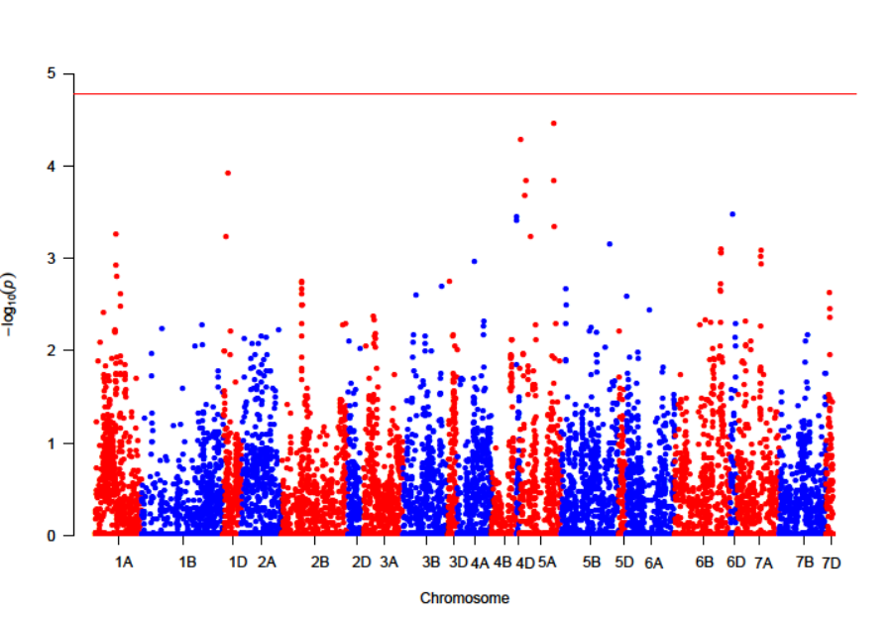
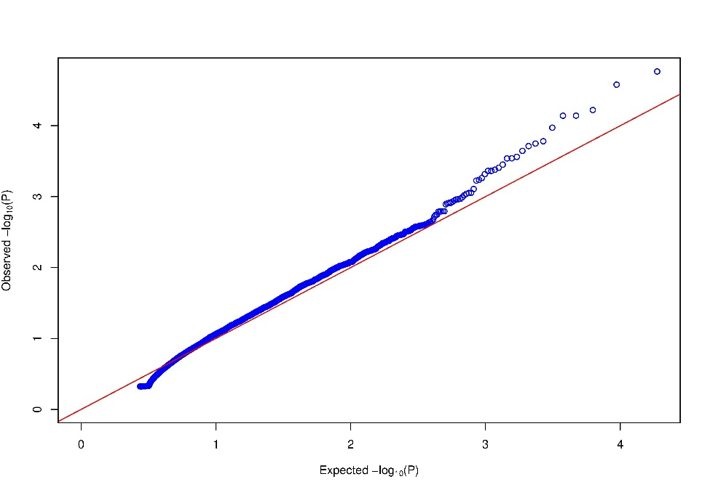
d
FLW2017
FLW2018

Slide 6
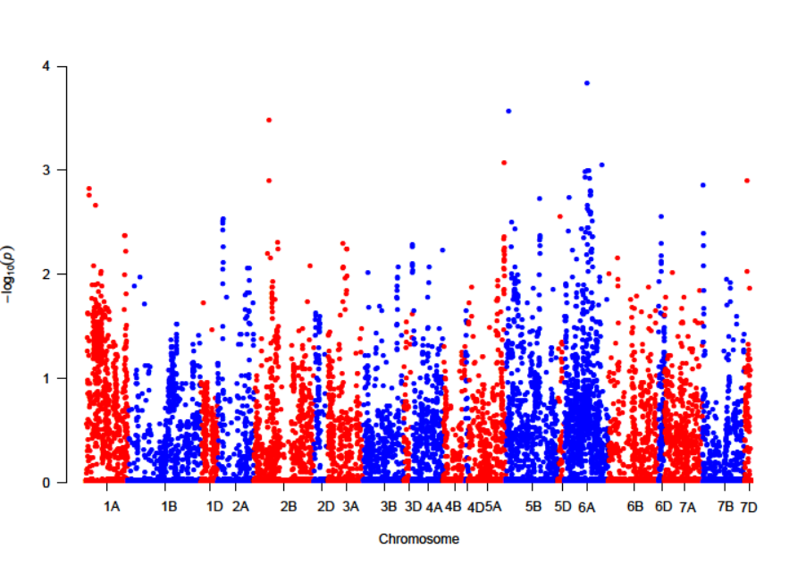
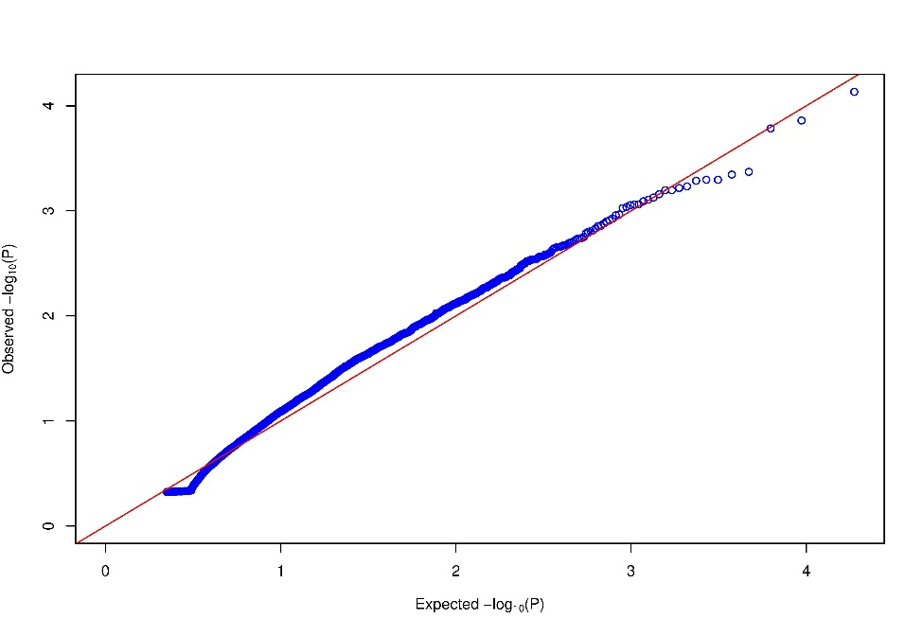
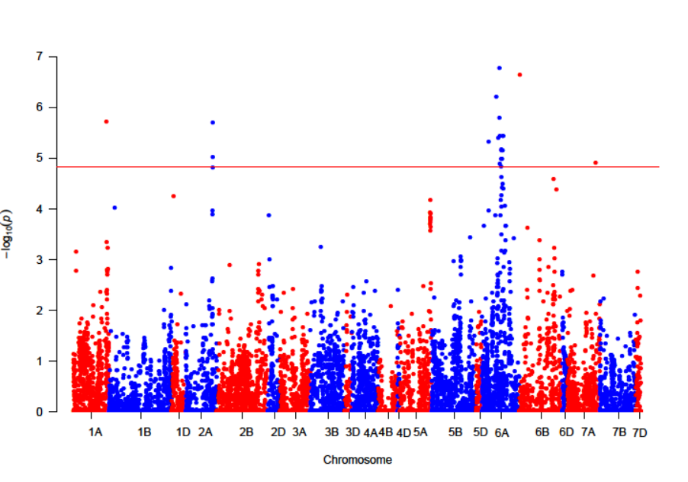
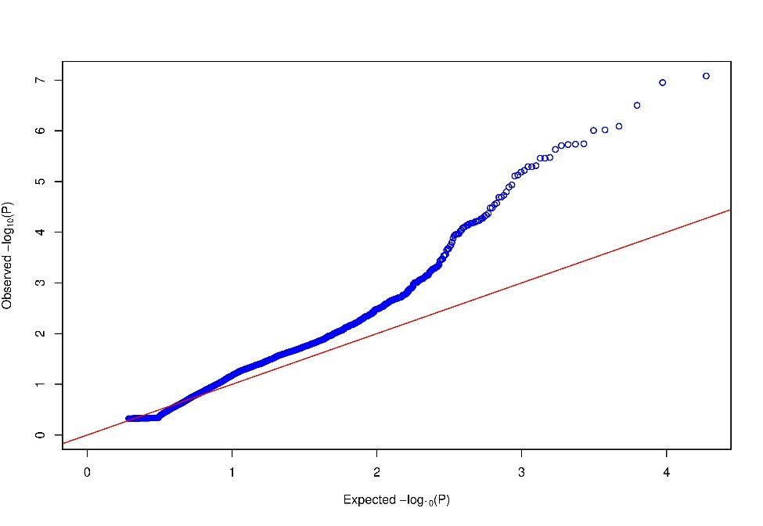
e
TILL2017
TILL2018

